Slide 1
Operating Systems
CHAPTER-5
I/O Management & Disk Scheduling

Slide 2
Categories of I/O Devices
Input/Output
I/O devices can be divided into two categories:
1- Block Devices
2- Character Devices

Slide 3
Block Devices
A block device is one that stores information in fixed-size blocks each one with its own address.
The essential property of a block device is that it is possible to read/write each block independently.
Disks are the most common block devices.
Where the arm currently is, it is always possible to seek to another cylinder and then wait for the required block to rotate under the head.
Input/Output

Slide 4
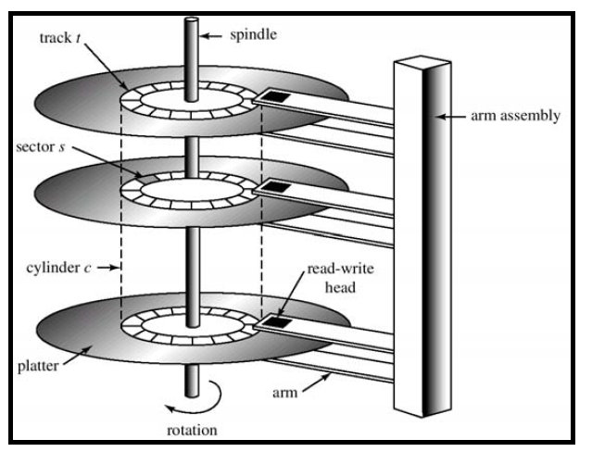
Input/Output
Moving Head Disk Mechanism

Slide 5
Input/Output
Character Devices
It accepts a stream of characters without regard to any block structure.
Printers, NIC, mouse and other devices (that are not disk like) are character devices.

Slide 6
Categories of I/O Devices
Input/Output
Human Readable
  Used to communicate with the user
  Printers
  Video display terminals
    Display
    Keyboard
    Mouse

Slide 7
Categories of I/O Devices
Input/Output
Machine Readable
  Used to communicate with electronic equipment
  Disk and tape drives
  Sensors
  Controllers
  Actuators

Slide 8
Categories of I/O Devices
Input/Output
Communication
  Used to communicate with remote devices
  Digital line drivers
  Modems
  Routers
  Switches
  Hubs etc

Slide 9
Input/Output
Device Controllers (adapter OR I/O Modules)
I/O devices have components:
1- Mechanical component
2- Electronic component
The electronic component is called the device controller or adapter.
It takes the form of printed circuit card that can be inserted into an expansion slot.
The mechanical component is a device itself.
This arrangement is shown in the next slide

Slide 10

Input/Output
Monitor
Bus

Slide 11
Input/Output
Many controllers can handle two, four or even eight identical devices, if the interface between the controller and the device is standard interface
Controller's tasks
  Convert serial bit stream to block of bytes
  Perform error correction as necessary
  Make available to main memory

Slide 12
Differences in I/O Devices
Input/Output
In telecommunications and computing, bit rate (sometimes written bit rate, data rate is the number of bits that are conveyed or processed per unit of time.
Data Rate
  May be differences of several orders of magnitude between the data transfer rates

Slide 13
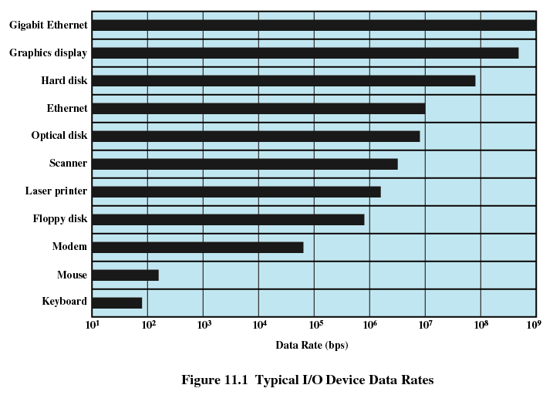
Input/Output

Slide 14
Differences in I/O Devices
Input/Output
Application
  Disk used to store files requires file management software
  Disk used to store virtual memory pages needs special hardware and software to support it
  Terminal used by system administrator may have a different privilege levels and have different priorities in the operating system

Slide 15
Differences in I/O Devices
Input/Output
Complexity of Control
A printer requires a simple control interface. A disk is more
complex.
Unit of Transfer
Data may be transferred as a stream of bytes for a terminal or in larger
blocks for a disk
Data Representation
Different data encoding schemes are used by different devices.
Error conditions
Devices respond to errors differently (the way in which they are reported)

Slide 16
Input/Output
Goals of I/O Software
Device independence
  programs can access any I/O device
  without specifying device in advance
    (floppy, hard drive, or CD-ROM)
Uniform naming
  name of a file or device a string or an integer
  not depending on which machine
Error handling
  handle as close to the hardware as possible

Slide 17
Input/Output
Goals of I/O software
Shareable vs. dedicated devices
  disks are sharable
  tape drives are dedicated
  Disks can be used by many users at the same time.
  No problem are caused by multiple users having open files on the same disk at the same time.
  Tape drives have to be dedicated to a single user until that user is finished.

Slide 18
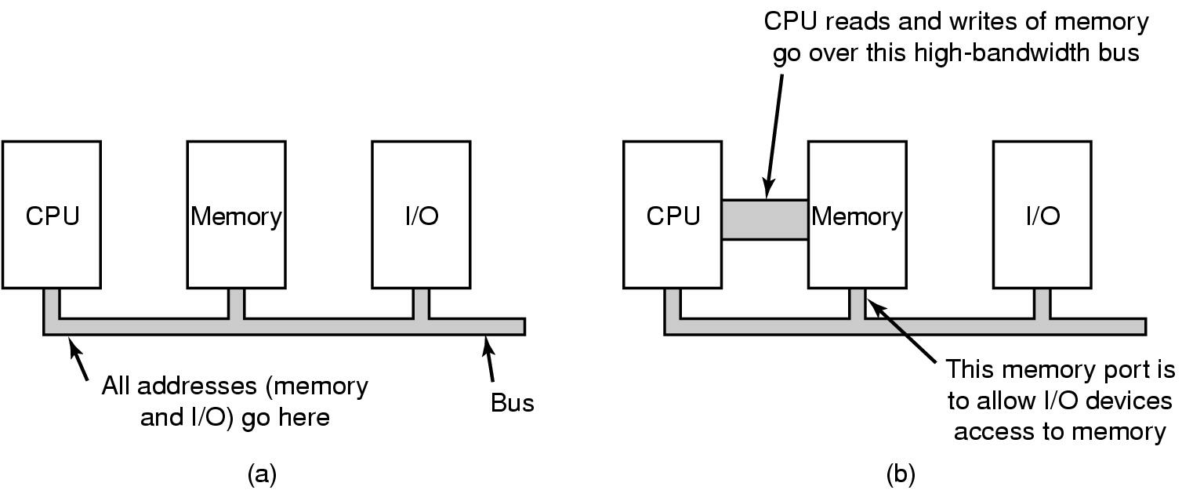
Input/Output
(a) A single-bus architecture
(b) A dual-bus memory architecture

Slide 19
Evolution of the I/O Function
Input/Output
Processor directly controls a peripheral device
Controller or I/O module is added
  Processor uses programmed I/O without interrupts
Controller or I/O module with interrupts
  Processor does not spend time waiting for an I/O operation to be performed
Direct Memory Access
  Blocks of data are moved into memory without involving the processor
  Processor involved at beginning and end only

Slide 20
I/O Communication Techniques
Three techniques are possible for I/O operations:
1- Programmed I/O
2- Interrupt-driven I/O
3 -Direct Memory Access (DMA)
Input/Output

Slide 21
Programmed I/O
Input/Output
  With this technique, the processor is responsible for extracting data from main memory for output and storing data in main memory for input.
  Processor is responsible to move the block of data to or from the memory.
  The processor executes instructions that give it direct control of the I/O operation, including sending a read or write command and transferring the data.
  When the processor is executing a program related to I/O, it executes that instruction by issuing an I/O command to an I/O module,. The I/O module performs the requested action but take no further action (is it ready to transmit/exchange more data with the processor) to alert the processor that I/O operation has been completed. The processor periodically checks the status of I/O module until it finds that the operation is complete.

Slide 22
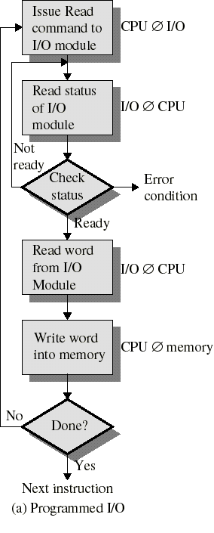
Programmed I/O
Input/Output
I/O module performs the action, on behalf of the processor
But the I/O module does not interrupt the CPU when I/O is done
Processor is kept busy checking status of I/O module
  Programmed I/O
    Does not use interrupts: CPU has to wait for completion of each I/O operation

Slide 23
Input/Output
Programmed I/O
The simple form of I/O is to have the CPU do all the work. This method is called programmed I/O.
A user process wants to print eight character string “ABCDEFGH” on the printer.
It first assembles the string in a buffer in user space as shown in fig (a).
The user process then acquires a printer by making a system call to open it.
If the printer is currently in use by another process, this call will fail and return an error code or will block until the printer is available.
Once it has the printer, the user process makes a system call telling the OS to print the string on the printer.
The OS then copies the string in to an array, in kernel space.

Slide 24
Input/Output
As soon as the printer is available it copies the first character to the printer’s data register. This action activates the printer.
In fig (b) we see the first character has been printed and that the system has marked the “B” as the next character to be printed.
This loop continues until the entire string is printed.

Slide 25
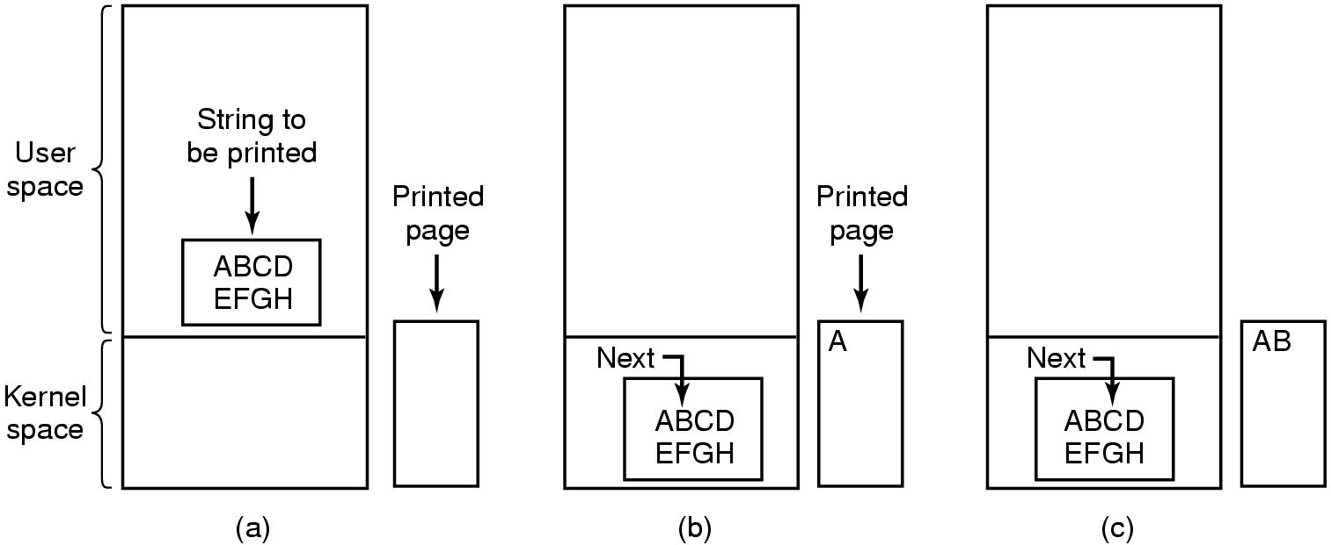
Input/Output

Slide 26
Input/Output
PROBLEM With Programmed I/O
The problem with Programmed I/O technique is that the processor has to wait a long time for the I/O module of concern to be ready for transmission or exchange of more data with the processor.
The processor while waiting must repeatedly monitor the status of the I/O module.
The performance level of the entire system is degraded.

Slide 27
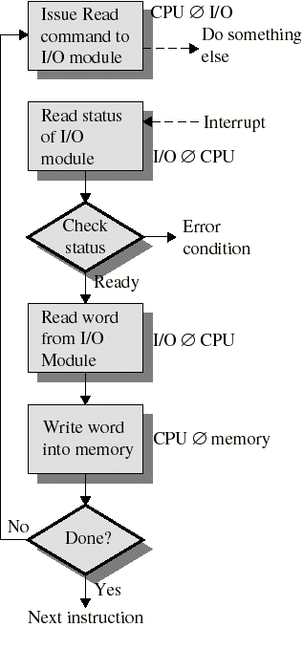
Interrupt-Driven I/O
Input/Output
Processor is interrupted when I/O module ready to exchange data
Processor is free to do other work
No needless waiting
Consumes a lot of processor time because every word read or written passes through the processor

Slide 28
Interrupt-Driven I/O
Input/Output
  I/O command is issued.
  Processor continues executing subsequent instructions.
  I/O module sends an interrupt when done.

Slide 29
PROBLEMS with Interrupt-Driven I/O
Input/Output
  It is more efficient than programmed I/O technique,
  still it requires the active intervention of the
  processor to transfer data between memory and I/O
  module, and any data transfer must traverse a
  path through the processor.

Slide 30
Direct Memory Access (DMA)
Input/Output
  The DMA function can be performed by a separate module on the system bus or it can be incorporated into an I/O module.
  When the processor wished to read or write a block of data, it issues a command to the DMA, the processor then continues with other work. It has delegated this I/O operation to DMA module.
  The I/O module is given direct control of memory via DMA. It can now move a block of data to or from memory without involving the processor, except at the beginning and end of the transfer.
  When the transfer is complete, the DMA module sends an interrupt signal to the processor. Thus the processor is involved at the beginning and at the end of the transfer.
  DMA module controls exchange of data between main memory and the I/O device.

Slide 31
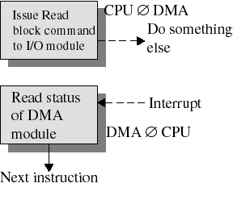
Input/Output
CPU issues request to a DMA module (separate module or incorporated into I/O module)
DMA module transfers a block of data directly to or from memory (without going through CPU)
An interrupt is sent when the task is complete
The CPU is only involved at the beginning and end of the transfer
The CPU is free to perform other tasks during data transfer

Slide 32
Direct Memory Access (DMA)
Input/Output
Processor delegates I/O operation to the DMA module
DMA module transfers data directly to or form memory
When complete, DMA module sends an interrupt signal to the processor

Slide 33
Input/Output
SUMMARY
Programmed I/O:
The processor issues an I/O command, on behalf of a process, to an I/O module; that process then busy waits for the operation to be completed before proceeding.
Interrupt-driven I/O:
The processor issues an I/O command on behalf of a process. There are then two possibilities. If the I/O instruction from the process is non-blocking, then the processor continues to execute instructions from the process that issued the I/O command. If the I/O instruction is blocking, then the next instruction that the processor executes is from the OS, which will put the current process in a blocked state and schedule another process.
Direct Memory Access (DMA):
A DMA module controls the exchange of data between main memory and an I/O module. The processor sends a request for the transfer of a block of data to the DMA module and is interrupted only after the entire block has been transferred.

Slide 34
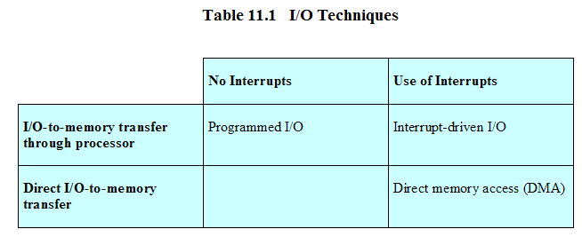
Relationship Among Techniques
Input/Output

Slide 35
Operating System Design Issues
Input/Output
Efficiency
  Most I/O devices extremely slow compared to main memory
  Use of multiprogramming allows for some processes to be waiting on I/O while another process executes
  I/O cannot keep up with processor speed
  Swapping is used to bring in additional Ready processes which is an I/O operation

Slide 36
Input/Output
Generality
  Desirable to handle all I/O devices in a uniform manner
  Hide most of the details of device I/O in lower-level routines so that processes and upper levels see devices in general terms such as read, write, open, close, lock, unlock

